Slide 1
NutriFitCLI
Nutrition Fitness Command Line Interface
{
<By> Suhas Sunder </By>
}
...

Slide 2
What is NutriFitCLI?
01
02
03
04
05
Built in Python
Add/Remove Meals & Exercises
View Activity Logs By Date
Track Calories Burned
Monthly Calendar Visual

Slide 3
Why NutriFitCLI?
Utilizes Fundamental Programming Concepts!
“Arrays”, “For Loop”, “While Loop”,
“Objects”, “JSON”, “Modules”, “Classes”,
“Constructors”, “Functions”, “Modules”,...
...“I/O Read/Write”, “RegExp”
[
..
]
..

Slide 4
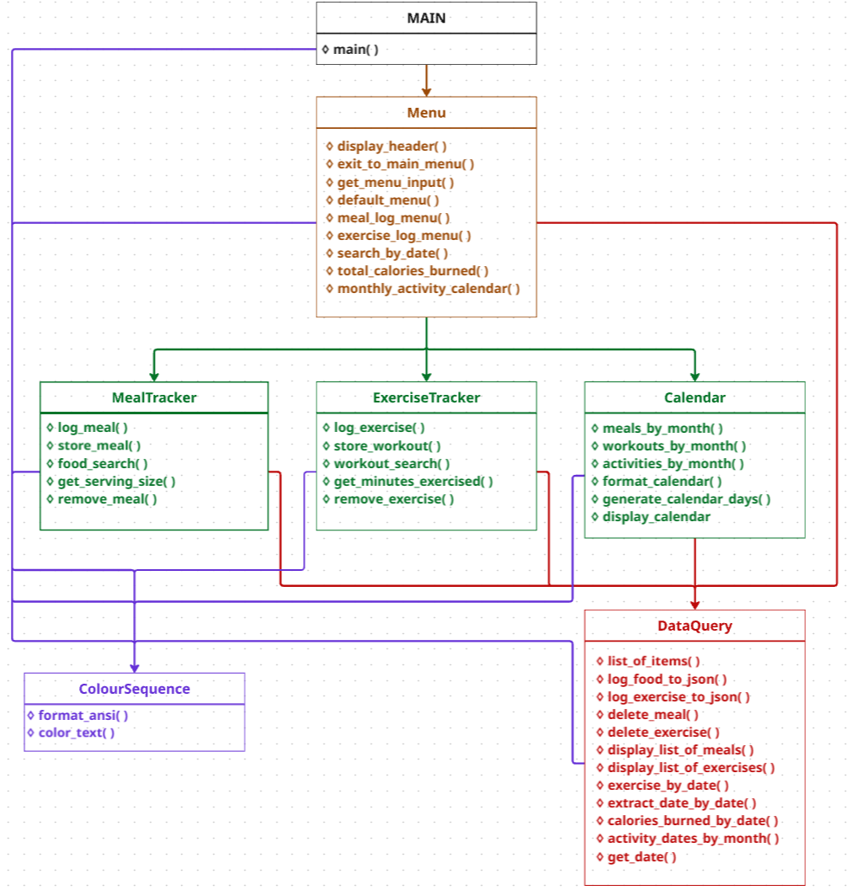
How does
it work?
{
> Main: Main Menu & Exit Msg
> Menu: Navigate Sub-Menus
> MealTracker: Meal Logging
> ExerciseTracker: Exercise Logging
> Calendar: Displays Calendar
> DataQuery: Read/Write JSON files
> ColourSequence: Formats Output Text
}
...

Slide 5
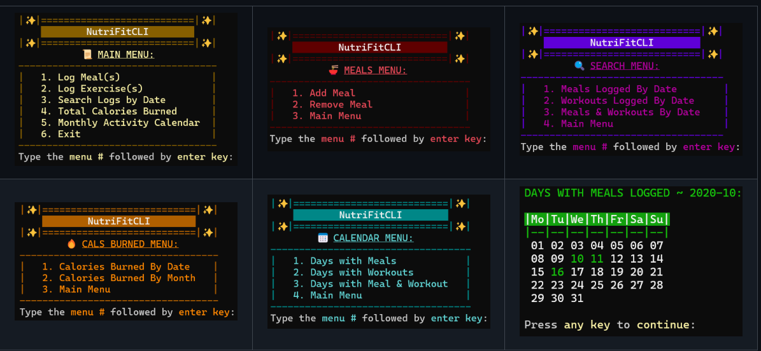
Questions?
*

